Slide 1
Updates to the VA CIRB MOU
Dial in: (914) 614-3221
Access Code: 998-201-117
Slides in “Handout” Tab
Annette Anderson, MA
IRB Administrator, VA CIRB
ORPP&E
October 8, 2019

Slide 2
Overview
Dial in: (914) 614-3221
Access Code: 998-201-117
Slides in “Handout” Tab
General overview of the VA Central IRB
Changes to the MOU
Coordination and approval process for MOU
Process for updating FWA to add 2nd VA Central IRB panel as an IRB of record
Facility Liaison Responsibilities
VA Central IRB SharePoint Site Profile
Availability of site-specific reports

Slide 3
Dial in: (914) 614-3221
Access Code: 998-201-117
Slides in “Handout” Tab
General Overview of the VA Central IRB

Slide 4
Background and Current Status
Established as part of the VHA Central Office Human Research Protection Program (HRPP) in 2008
Institutional Official (IO) is Under Secretary of Health for Discovery, Education, and Affiliate Networks (DEAN) and Human Protections Administrator (HPA) is Director, ORPP&E
First study reviewed in August 2008 and approved in October 2008
As of September 30, 2019, the VA Central IRB is overseeing or is in the process of reviewing a total of 248 multi-site studies involving a little over 1,693 sites
Reviews funded, multi-site studies as IRB of record for participating VA sites

Slide 5
Local VA Facility Requirements to Use the VA Central IRB
Local VA Facilities must:
Amend Facility Federalwide Assurance to list the VA Central IRB as an IRB of Record; affiliated NPCs must amend FWAs as well
Enter into a Memorandum of Understanding (MOU) with the VHA Central Office and affiliated NPC if applicable
Develop Standard Operating Procedures (SOPs) for using the VA Central IRB as an IRB of Record
Note: Most facilities (108) have already completed this step.

Slide 6
Memorandum of Understanding (MOU)
Spells out the respective authorities, roles, and responsibilities of the VHA Central Office HRPP, the VA Central IRB, the local VA facility, and the affiliated NPC if applicable
VA facilities that do not use the VA Central IRB will not be able to participate in studies reviewed by the VA Central IRB
Requires local VA Facility Medical Director to appoint local site representatives to 1) serve as a liaison to the VA Central IRB and 2) serve as designee to review VA Central IRB initial determination on new studies and provide any local comments

Slide 7
Local and Other Oversight of the VA CIRB
VA Central IRB is an external committee to the local site and an internal VA IRB
No longer a subcommittee of the R&D Committee
Annual HRPP report, unredacted copies of meeting minutes, and determination letters still provided to sites
Local site comment period and Local Site Liaisons
Local Research Compliance Officers
VHA Office of Research Oversight
Notes:
R&D Committee must review all research related committees and subcommittees at least annually. When a VA facility uses an IRB other than its own internal IRB, the role of the R&D Committee is to review and evaluate facility-specific aspects of these relationships, rather than the subcommittee itself, to ensure the obligations as detailed in the MOU are being met (VHA Directive 1200.01 paragraph 6f).

Slide 8
VA CIRB Composition and Meeting Schedule
14 voting members from across the country comprised of:
2 VA Central IRB Co-Chairs (1 MD and 1 Research Pharmacist)
10 additional scientists (7 MDs and 3 PhDs)
1 non-affiliated non-scientist and 1 affiliated non-scientist
4 nonvoting members
VHA National Center for Ethics in Health Care
VHA Office of General Counsel
VHA Privacy Office (with 1 alternate)
Information Systems Security Office (with 1 alternate)
Meets twice a month via teleconference (2 meetings a year in person

Slide 9
Upcoming Big Structural Change
The VA Central IRB will be adding a second panel with the first meeting scheduled for early November 2019
Composed of some members of current panel plus some new members and two new Co-Chairs
Same meeting schedule and will use same policies and procedures – should be fairly transparent to local sites and study teams
Supported by current admin staff
More panels may be added depending upon future workload
Each panel will be leaner (but not meaner!)

Slide 10
Changes to the MOU in this Revision
Two Revised Templates – One includes NPC as signatory and the other does not include NPC for those facilities that don’t have one
ORO has reviewed this updated version of the MOU
Notes:
MOU template recently sent out omitted the NPC signature block. Please use the version included in the handouts and uploaded to the VA CIRB website.

Slide 11
Reasons for Update of MOU
This revision was done to accomplish the following:
Incorporate the 2018 Common Rule requirements
Incorporate requirements of revised VHA Directives 1200.05 and 1200.01
Update the MOU prior to its renewal cycle which is coming up for many of the sites at the end of this year and early 2020
Include more than one panel of the VA Central IRB under the MOU

Slide 12
Over-arching General Changes
Streamlining of MOU – reduced by two pages by deleting provisions that did not need to be there and are better addressed in SOPs
Updated wording and references to reflect current terminology – such as the use of ISSO instead of ISO, and changed “Handbooks” to “Directives,” etc.
Clarified provisions that sites had previously indicated were confusing by adding more specificity
Eliminated as much duplication as possible

Slide 13
Specific Changes from Previous MOU
Agreement period is now 5 years instead of 3
Added references to multiple panels of the VA Central IRB
Indicated that all panels must be added to facility and NPCs FWA (paragraph B6)
Clarified when the VA Central IRB would charge for reviews and when it would not (paragraph B8)
Changed frequency of meetings to twice a month with flexibility to cancel meetings for specified reasons (paragraph C6)

Slide 14
Specific Changes to MOU (Continued)
Added a provision that the MOU does not guarantee that all studies from a site or study team that meet criteria for review will actually be accepted for review (paragraph C7)
Clarified reporting requirements of the site to ORO, OHRP, and the FDA as applicable (paragraphs C13 and D1e)
Added that the VA Central IRB will perform limited IRB review for qualified multi-site exempt studies and indicated what this review would entail and possible outcomes (paragraph C14)
Added a paragraph on how the VA Central IRB will distribute correspondence (SharePoint site, e-mail or through designated electronic platform (paragraph C15)

Slide 15
Specific Changes to MOU (Continued)
Clarified routine reporting of RCO audits to the VA Central IRB, as well as reports of apparent serious noncompliance, by adding additional specificity (paragraph D1c)
If a facility uses another VA facility’s R&D Committee that facility must ensure the MOU with the overseeing R&D committee references studies approved by the VA Central IRB as an IRB of Record (paragraph D2)
Added clarification about when LSI Applications should be submitted (paragraph D4)

Slide 16
Specific Changes to MOU (Continued)
Added clarification that the VA Central IRB does not review emergency use or non-emergency/compassionate use requests (paragraph D9)
Changed notification requirement for termination from 60 to 90 days (paragraph F2)
While there have been many minor changes over the years, the “bones” of the agreement have remained essentially unchanged.

Slide 17
Processing MOU for Signature and Adding VA Central IRB Panel #2 to Facility and NPC FWA

Slide 18
Processing MOU for Signature
This process has not changed.
The MOU requires the signature of the Medical Center Director and the VISN Director
Signature can be electronic
Once both signatures are obtained, e-mail to VA Central IRB either at vacentralirb@va.gov, Annette.anderson3@va.gov, or Lindseymartin2@va.gov
VA Central IRB staff will obtain signature of VHACO representative and then e-mail copies of signed documents to ORO and to the facility

Slide 19
Addition of 2nd VA Central IRB Panel
Once panel is registered, VA Central IRB Administrator will send out registration information to all Local Site Liaisons
Liaisons will need to update their FWAs by adding the 2nd panel as an additional IRB of Record
Follow normal process for updating FWAs as described at www.va.gov/oro/fwa.asp
VA requires all IRBs used by a VA facility to be designated on the FWA, which is a stricter requirement than OHRP. Questions may be sent to OROFWA@va.gov

Slide 20
Changes in Signatory Officials
When either the Medical Center Director or the NPC IO changes, facilities must update their FWAs and submit VA Central IRB Form 143, Amendment to Memorandum of Understanding (MOU) to Lindsey.martin2@va.gov or to vacentralirb@va.gov. VA facilities are also still required to complete the VA Addendum to the FWA.
VA Central IRB staff will update the VA Central IRB database with the change and also send a copy to ORO
VA Central IRB receives a notice from OHRP when there is a change in facility FWAs for which it serves as an IRB of record; if a Medical Center Director or NPC IO changes, VA Central IRB staff will ask the site to submit an amendment if one has not already been received.
Submission of VA Central IRB Form 143 is not required if the FWA change does not involve a change in either IO

Slide 21
VA Central IRB Local Site Liaison Responsibilities

Slide 22
Communication is Key Function!
VA Central IRB Local Site Liaisons serve as the main point of contact at their sites for the VA Central IRB and they are appointed by each Medical Center Director
Local Site Liaisons are copied on all determination letters for studies in which the site will be/is a participating site
Updated VA Central IRB Local Site Liaison handout contains specific responsibilities, to include a section Site Designee responsibilities (Liaison and Designee can be the same person)
We appreciate and value the site liaisons and local RCOs as they are often our “eyes and ears” regarding what is going on at a site for a particular study

Slide 23
Effective Communication is a Two-way Street
In order to ensure the VA Central IRB communicates with the appropriate personnel at the site, it needs to be kept informed of changes in local site personnel.
This includes contact information for the VA facility and NPC IOs, Local Site Liaisons, R&D Committee Coordinators, Site Designees, and RCOs.
Also routinely track ACOS/R&D, AO, and local IRB Administrator(s) contact information
Annual call for local contact updates sent to Local Site Liaisons in late spring; will be instituting quarterly reminders to keep VA Central IRB informed of changes in site personnel

Slide 24
VA Central IRB SharePoint Site and Availability of Site-specific reports

Slide 25
Who has Access at the Local Site?
Once a site is identified as potentially participating in a study, the VA Central IRB Manager requests that access to that study folder be given to both study team members and local site staff as follow:
Local Site Liaison (Primary and Secondary)
R&D Committee Coordinators
RCOs
Site Designees
Coordinating Center Managers if applicable
Liaisons and CSP Mangers also copied on acknowledgment letters for new studies

Slide 27
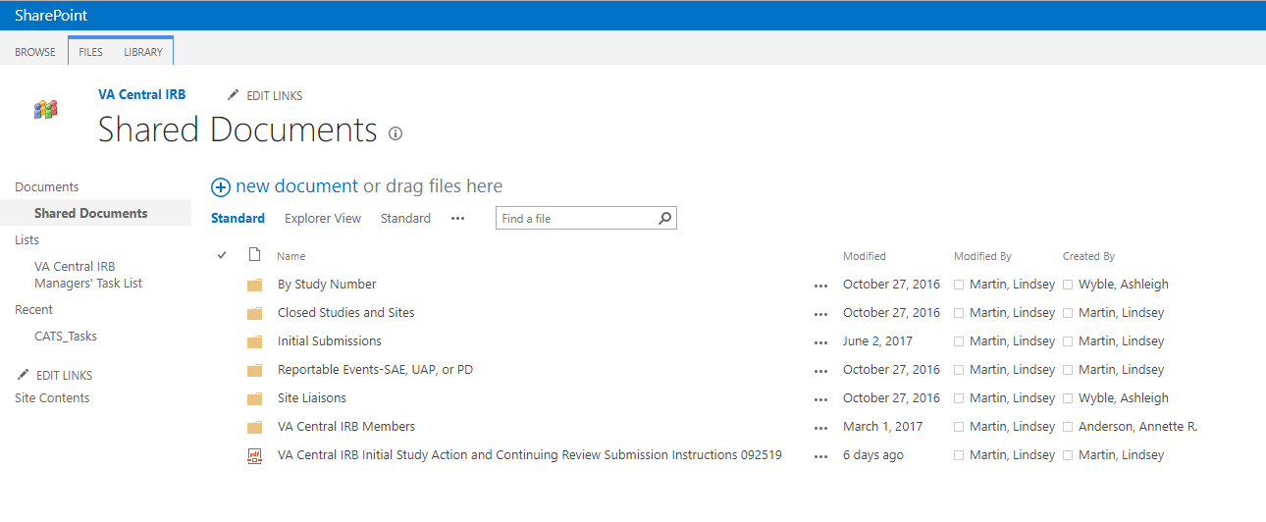

Slide 28
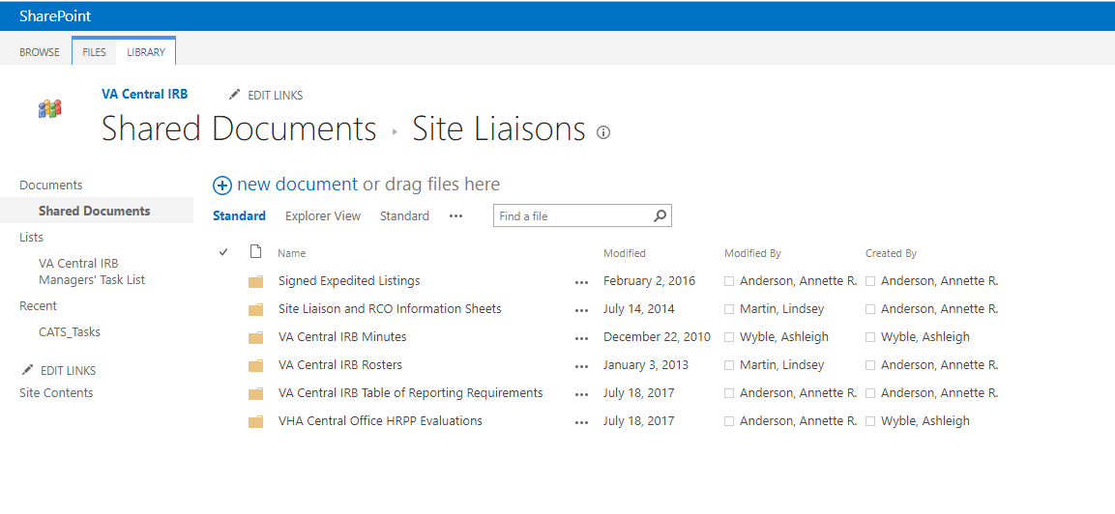

Slide 29
Types of Site-specific Reports Available
The VA Central IRB can make available the following reports to sites upon request:
List of PI/SC studies active at site
List of LSI studies active at site
List of studies by funding sources at site (both PI and LSI)
List of SAEs and protocol deviations on a particular study by site
Other reports might be available upon request
If you need one of these reports, you can either contact the VA Central IRB Manager for the study or myself, call our toll-free line, or send an e-mail to our general e-mail address

Slide 30
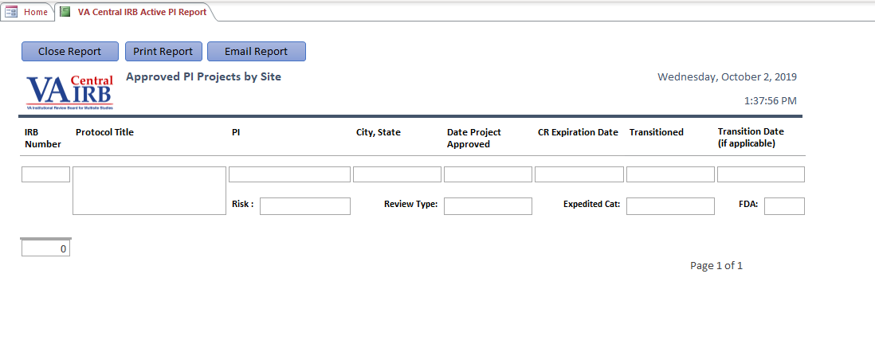

Slide 31
Upcoming SharePoint Site Changes
Our SharePoint site has been moved to the cloud!
Undergoing two week user validation that will end Oct 15th
Old site is still active but will become read only after user testing is complete and users will be re-directed to the new site for a period of approximately 30 days
All access permissions should transfer but there will be different links
We will send out an e-mail with the new link to site liaisons, RCOs, and R&D Coordinators when new site is active

Slide 32
Contact Information
Annette Anderson, MS FWA POC: Priscilla Craig
IRB Administrator, VA Central IRB Health Science Specialist
Office of Research Protections, Policy, and Education Policy and Education
Office of Research and Development Office of Research Oversight
Washington, DC Washington, DC
Annette.Anderson3@va.gov Priscilla.Craig@va.gov
E-mail: va.central.irb@va.gov
Toll Free Number: 877-254-3130
Website: http://www.research.va.gov/vacentralirb/default.cfm
VA Central IRB Co-Chairs
Fred Hendler, MD, PhD Stephen Bartlett, RPh, MSPH
Fred.hendler@va.gov Stephen.bartlett2@va.gov
502-287-4000 ext. 55131 702-857-5709

Slide 33
VA Central IRB Managers and Other Staff
Current VA Central IRB Managers
Hector Ramirez 202-443-5656 hector.ramirez@va.gov
Christie O’Brien 202-443-5660 christie.obrien@va.gov
Kendra Clarke 202-443-5677 kendra.clarke@va.gov
Michele McGee 202-443-5651 michele.mcgee@va.gov
Mary Eckart Remote mary.eckart@va.gov
Rishima Weston 202-443-5642 rishima.weston@va.gov
SharePoint , ACCESS, MOUs, and Reportable Event Reporting
Lindsey Martin 202-443-5653 lindsey.martin2@va.gov
Erica Aulik Remote erica.aulik@va.gov
Pauline Cilladi-Rehrer 202-443-5607 pauline.cilladi-rehrer@va.gov
Angie Foster 202-443-5822 angela.foster@va.gov

Slide 34
Questions?

